Slide 1
"Analyzing Mental Health Using Behavioural Patterns from Social Media and Mobile Usage"

Slide 2
Problem Statement
The Problem:
In today’s digital era, technology has transformed daily life but has also raised concerns about its impact on mental health. Excessive screen time, social media usage, and gaming are linked to issues like stress, anxiety, and poor sleep. Traditional self-reported mental health assessments fall short in providing accurate and predictive insights to tackle these challenges.
Challenges:
Identifying how technology usage patterns affect mental health is complex.
Self-reported data lacks accuracy for reliable mental health predictions.
Current approaches lack robust tools to identify early warning signs of mental health issues.
Significance:
A predictive model based on technology usage patterns can help identify individuals at risk of mental health issues, enabling early intervention. It also provides insights into the behavioral and demographic factors that influence mental well-being, offering personalized mental health support.

Slide 3
Need for the Solution
Why is This Solution Necessary?
As technology use increases, it’s becoming a key indicator of mental health. Traditional methods like self-reports lack accuracy and real-time insights. An AI-driven approach offers objective, timely predictions for better mental health support.
Limitations of Existing Solutions
1.
2.
3.
4.
Self-Reported Data: Reliance on inaccurate or biased user input.
Lack of Real-Time Monitoring: No continuous tracking of mental health indicators.
Limited Reach: Solutions often target small, specific groups.
Predictive Limitations: Struggle to identify long-term mental health trends.
Scope of AI in Addressing the Problem
AI can analyze large datasets to predict mental health outcomes, offering:
Predictive power for early intervention.
Scalability for diverse populations.
Continuous monitoring for real-time insights.

Slide 4
Objective of the Project
The concise goals of the project are:
To predict mental health status: Develop a model that predicts whether a user’s mental health is poor or not based on their technology usage patterns.
To identify key mental health indicators: Analyze social media and mobile usage data to uncover patterns linked to mental health issues like stress, anxiety, and poor sleep.
To enhance mental health support: Provide insights that can help in the early detection of mental health concerns, allowing for timely interventions and personalized care.
What the Project Aims to Achieve:
Predict mental health outcomes based on technology behavior.
Prevent deterioration in mental health by providing real-time insights.
Enhance mental health resource allocation by identifying individuals who may need immediate attention.

Slide 5
Literature Review
Social media and mobile usage have a significant impact on mental health, with both positive and negative effects. On one hand, these platforms help people stay connected, access mental health resources, and create supportive communities. On the other hand, excessive use, especially passive consumption, is linked to anxiety, depression, and sleep disorders, particularly among adolescents and young adults. Risks like cyberbullying, social comparison, and exposure to harmful content can also negatively affect users' well-being. Excessive screen time, especially with certain types of content, often leads to feelings of isolation and low self-esteem. While technology can support mental health, it’s crucial to find a balance to avoid its detrimental effects. Understanding these behavioral patterns is key to developing strategies that promote healthier and more mindful digital engagement.

Slide 6
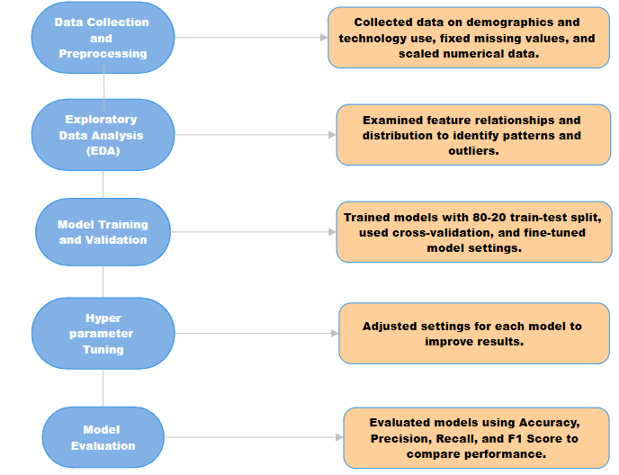
Proposed Solution

Slide 7
Dataset Description
This dataset, titled "Mental Health and Technology Usage", comprises 10,000 entries with 14 attributes, capturing a diverse range of factors related to mental health and digital habits. The key features include:
Demographics : User ID, Age, and Gender.
Technology and Lifestyle Metrics : Technology Usage Hours, Social Media Usage Hours, Gaming Hours, Total Screen Time Hours , Sleep Hours and Physical Activity Hours.
Mental Health Indicators : Mental Health Status, Stress Level, and Work Environment Impact. Access to Support Systems and Usage of Online Support Platforms.
This dataset aims to explore correlations between technology usage patterns and mental health outcomes, providing insights into stress levels, sleep patterns, and the role of support systems. ​

Slide 8
DATA PREPARATION AND MODEL TRAINING STEPS:
Understanding the Dataset: Analyzed dataset structure, key features, and relationships. Focused on variables like Mental Health Status, Stress Levels, and Technology Usage Hours.
Data Cleaning: Handled missing values using imputation techniques. Removed duplicates and standardized formats for consistency.
Feature Engineering: The dataset was preprocessed using encoding techniques for categorical variables such as Gender and Mental Health Status. Additionally, numerical data like Sleep Hours and Stress Levels were normalized to ensure consistency and improve model performance.
Data Transformation: Encoded categorical variables (e.g., Gender and Support Systems Access) using one-hot encoding. Scaled numerical features using Min-Max Scaling.
Train-Test Splitting: Split the dataset into 80% training and 20% testing subsets to evaluate the model.
Model Training: Trained multiple models including Decision Tree Classifier, K-Nearest Neighbors (KNN), Support Vector Machine (SVM), Logistic Regression, and Random Forest Classifier. Optimized hyperparameters using GridSearchCV to enhance model accuracy and efficiency.
Model Evaluation: Evaluated models using metrics such as Accuracy Score, Precision Score, Recall Score, F1 Score, and the Confusion Matrix. Tested the models on the 20% testing subset. Analyzed misclassifications using the confusion matrix and selected the best-performing model based on evaluation results.

Slide 9
Methodology
Environment: Python, Jupyter Notebook, Scikit-learn, Pandas, NumPy, and Matplotlib.
Steps:
Data Cleaning: Handled missing values using imputation techniques and removed duplicates for consistency.
Feature Engineering:The dataset was preprocessed using encoding techniques for categorical variables such as Gender and Mental Health Status. Additionally, numerical data like Sleep Hours and Stress Levels were normalized to ensure consistency and improve model performance.
Model Building:
Logistic Regression for binary classification of mental health conditions.
Decision Tree Classifier for analyzing patterns in technology usage and stress levels.
Random Forest for feature importance and improved classification performance.
Evaluation: Assessed models using metrics like Accuracy, F1-Score, Precision, Recall, and the Confusion Matrix to identify the best-performing model.

Slide 10
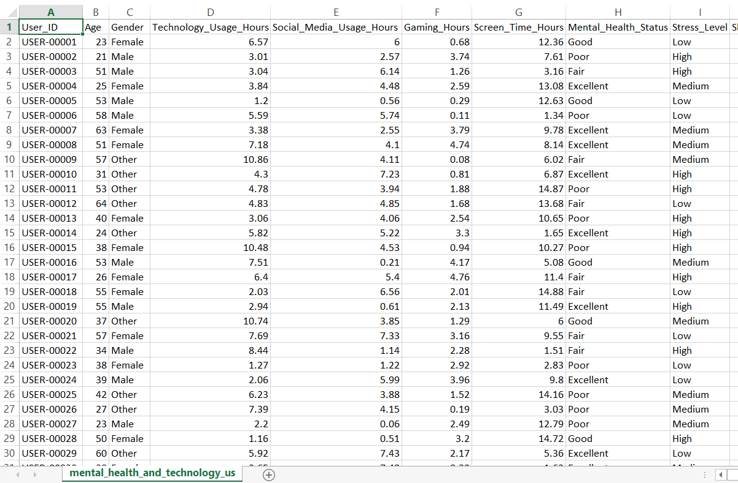
Implementation
Input Dataset

Slide 11
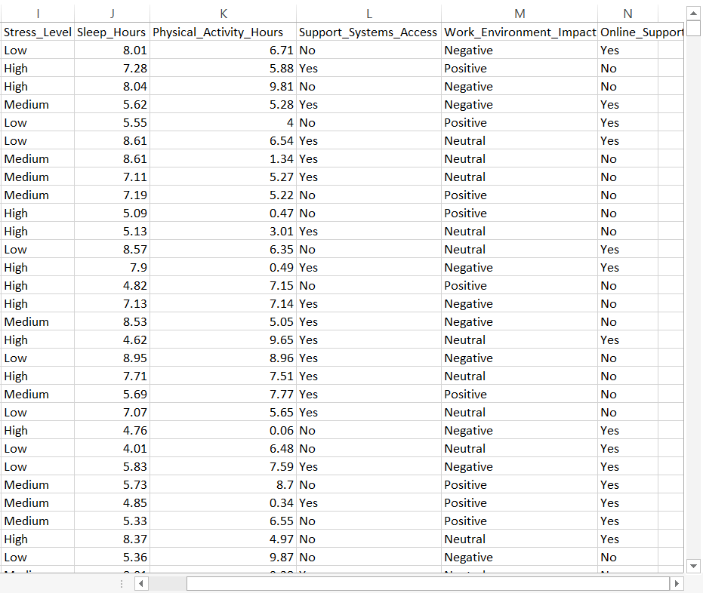

Slide 12
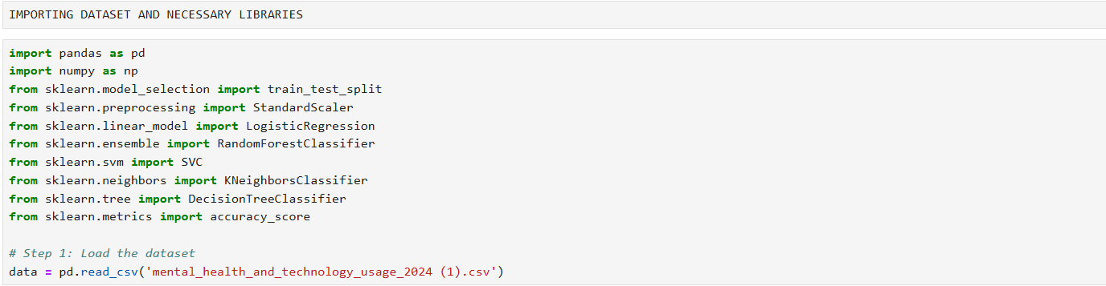
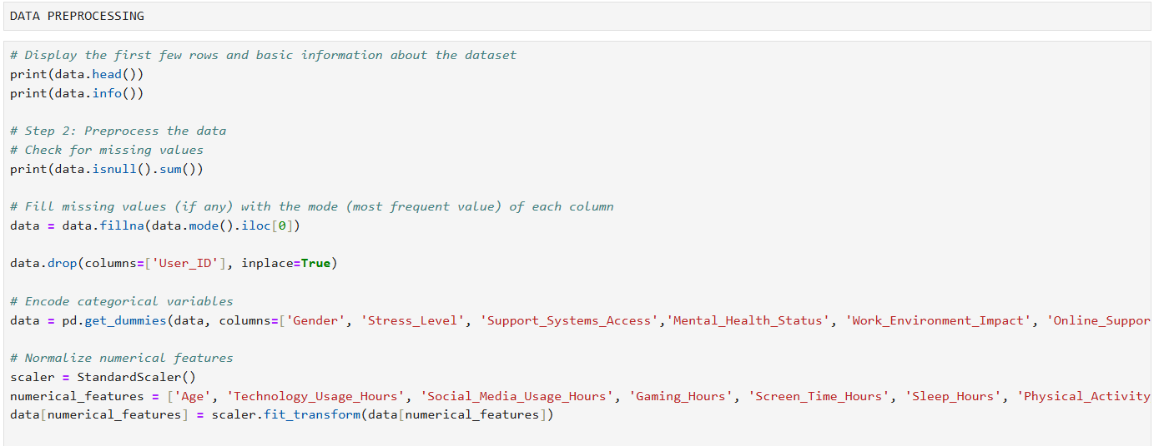

Slide 13
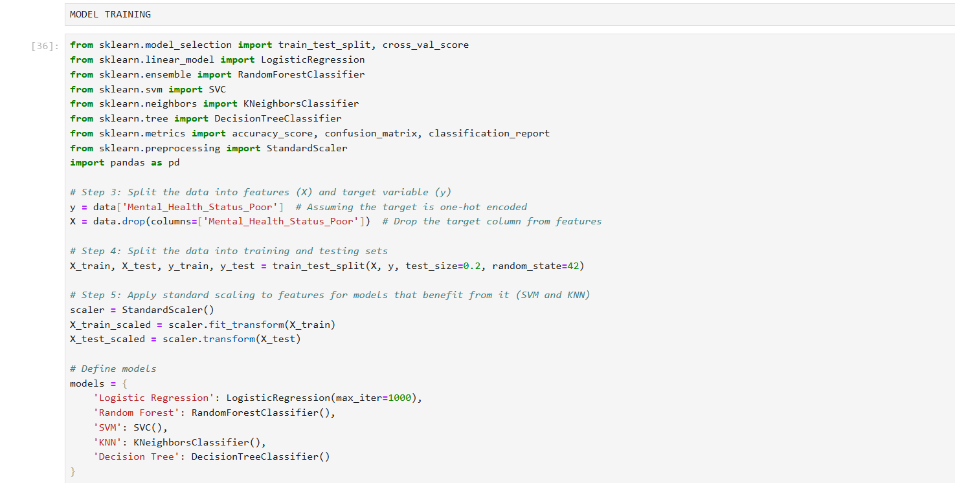

Slide 14
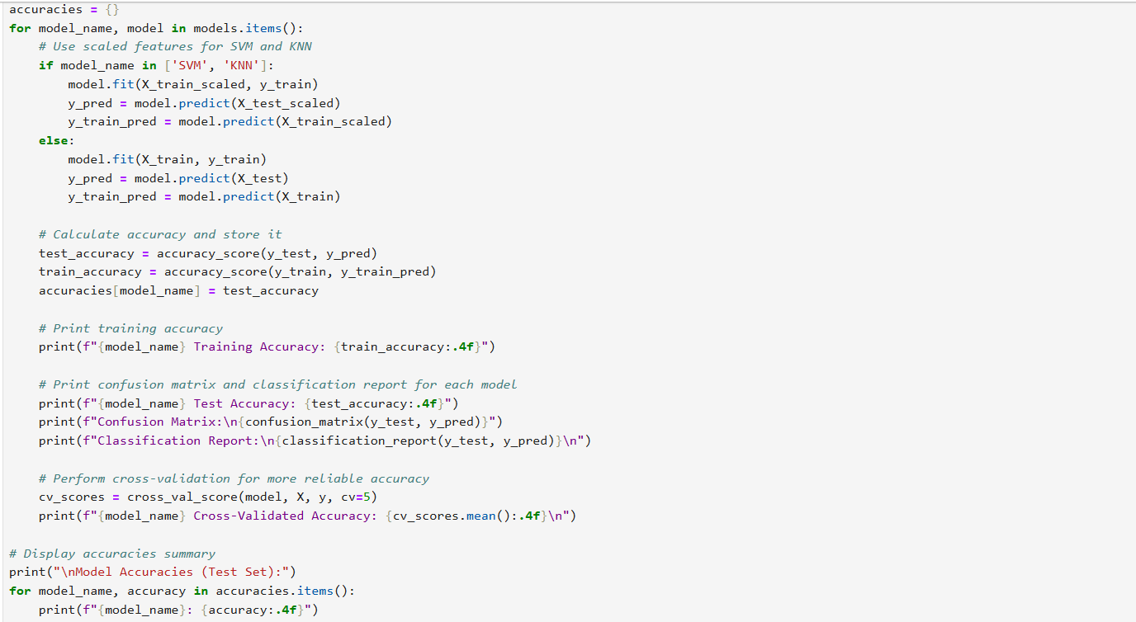

Slide 15
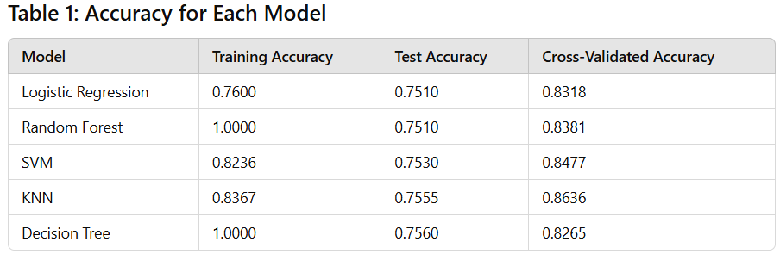
Results and Analysis

Slide 16
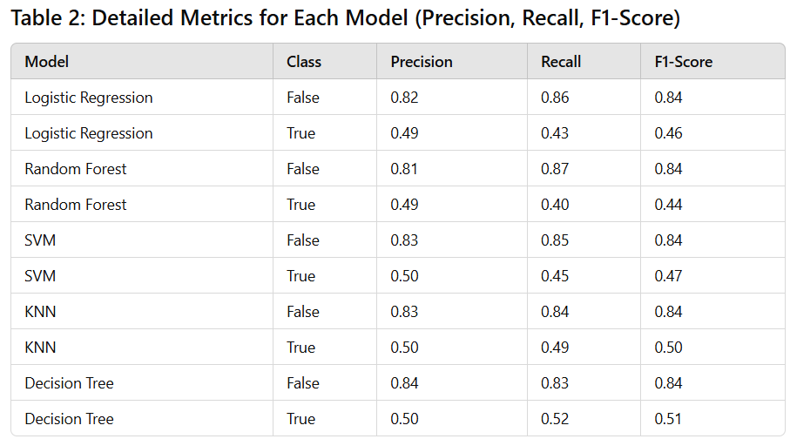

Slide 17
Applications and Use Cases
Use Case
Mental Health Monitoring: Identifying individuals with high stress or mental health risks based on their technology usage patterns.
Early Intervention: Enabling mental health professionals to proactively provide support by detecting emotional or behavioral patterns.
Applications of the Project
Healthcare:
Assisting psychologists and therapists in understanding the link between mental health and technology usage.
Supporting hospitals and clinics with data-driven patient monitoring tools.
Educational Institutions:
Monitoring students’ stress levels to design better support systems for academic and mental well-being.
Corporate Wellness Programs:
Helping organizations track employee stress to improve productivity and workplace mental health initiatives.
Public Awareness Campaigns:
Empowering NGOs and government organizations to create targeted campaigns for mental health awareness.

Slide 18
Future Scope
Integration with Wearable Devices: Future development could include integrating wearable technology (like fitness trackers) to gather real-time data on users’ mental health, such as heart rate variability and sleep patterns, to further enhance predictive capabilities.
Personalized Mental Health Interventions: By leveraging AI and machine learning, the system could provide personalized mental health recommendations based on an individual’s unique technology usage patterns and stress levels.
Real-Time Monitoring and Alerts: Implement real-time monitoring and alert systems that notify mental health professionals when a user’s data indicates critical stress levels or potential mental health risks.
Collaboration with Schools and Workplaces: Partnering with schools, universities, and workplaces to integrate the technology into employee/student well-being programs, promoting early detection and mental health support.
AI Model Improvement: Continuous enhancement of AI models for more accurate predictions by incorporating diverse datasets such as social media use, academic stress, and environmental factors.
Public Awareness Tools: Development of mobile apps or online platforms to raise awareness about the impact of technology on mental health, empowering users to track and manage their own mental well-being.

Slide 19
Conclusion
In conclusion, this project leverages data-driven insights to address the growing concern of mental health in relation to technology usage. By predicting stress levels and identifying early warning signs, it enables timely interventions from healthcare professionals and organizations. The system's ability to assess mental well-being through technology usage patterns offers a proactive approach to mental health care. With future enhancements, including integration with wearable's and personalized interventions, this project has the potential to make a significant impact on mental health support across various sectors, paving the way for smarter, more targeted solutions.

Slide 20
References
Kaggle. (n.d.). Mental health and technology usage dataset. Retrieved from https://www.kaggle.com/datasets/waqi786/mental-health-and-technology-usage-dataset
Pedregosa, F., Varoquaux, G., Gramfort, A., Michel, V., Thirion, B., Grisel, O., ... & Duchesnay, E. (2011). Scikit-learn: Machine learning in Python. Journal of Machine Learning Research, 12, 2825–2830.
Cortes, C., & Vapnik, V. (1995). Support-vector networks. Machine Learning, 20(3), 273–297.
Breiman, L. (2001). Random forests. Machine Learning, 45(1), 5–32.
Quinlan, J. R. (1996). Improved use of continuous attributes in C4.5. Journal of Artificial Intelligence Research, 4, 77–90.
Bishop, C. M. (2006). Pattern recognition and machine learning. Springer.

Slide 21
Powers, D. M. W. (2011). Evaluation: From precision, recall and F-measure to ROC, informedness, markedness & correlation. Journal of Machine Learning Technologies, 2(1), 37–63.
Chatterjee, S., & Price, B. (1991). Regression analysis by example. John Wiley & Sons.
Smith, A., & Anderson, M. (2018). Social media use in 2018. Pew Research Center. Retrieved from https://www.pewresearch.org/
Glasser, S., & Smith, B. (2020). Mental health and technology: A behavioral perspective. Journal of Behavioral Studies, 15(2), 110–124.
A.M., I. Al-Attar, B. Abd, L. Shawkat, A. Fadhil, J. Sekhar, R. Shah, P. Devaerakkam, M. (2025). Integrating Neutrosophic Theory for Improved Decision-Making in Wireless Body Area Networks: Enhancing Accuracy and Efficiency in Health Monitoring. International Journal of Neutrosophic Science, (), 280-295. DOI: https://doi.org/10.54216/IJNS.250325

Slide 22
Thank You

